Slide 1
OBE Implementation
Blooms Level Setting
Submitted By
K.Manaswi [AP22110010007]
S.Aswartha Harshitha [AP22110010012]
K.Swathi [AP22110010029]
P.Sudhamai [AP22110010031]
K.Madhavi [AP22110010042]

Slide 2
Introduction to Project
SRM University-AP is implementing the Outcome Based Education (OBE) system to improve educational effectiveness by aligning curriculum and assessments with intended outcomes. As part of this initiative, various modules are being developed to manage academic entities. I have been assigned the “Blooms Level Setting” module and developed a Windows application using Java AWT/Swing and SQLite to perform CRUD (Create, Retrieve, Update, Delete) operations.

Slide 3
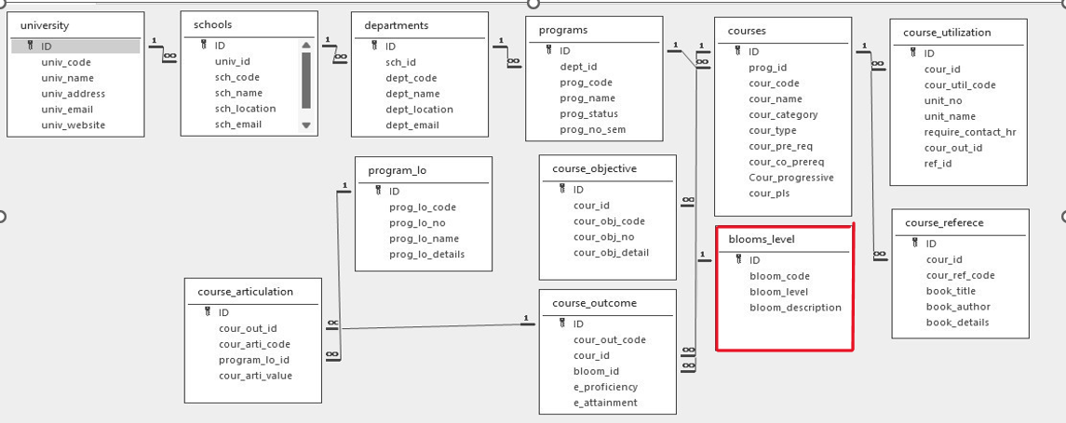
Architecture Diagram

Slide 4
Module Description
Module Name:
Blooms Level Setting Module
This module allows the admin to create, retrieve, update, and delete Bloom’s
Taxonomy levels. Each level contains a unique code, a descriptive level name, and its description. The data is stored in an SQLite database. This module facilitates the academic team in aligning course outcomes with appropriate Bloom’s levels.
Programming Details naming conventions to be used:
o Class name/activity name: BLOOMSLEVEL
o Func on/method name :
▪ Create: addBloom()
▪ Update: updateBloom()
▪ Retrieve: viewBloom()
▪ Delete: deleteBloom()

Slide 5
Blooms Level Setting:Field/table details
Field name | Data type
id | integer
bloom_code | String
bloom_level | String
bloom_description | String

Slide 6
Blooms Level Setting:Programming Details
File name: BLOOMSLEVEL
Function/method name
Create: addBloom()
Update: updateBloom()
Retrieve: viewallloom()
Delete: deleteBloom()

Slide 7
Source Code Database connection void connectDB() { try { Class.forName("org.sqlite.JDBC"); conn = DriverManager.getConnection("jdbc:sqlite:C:/Users/HP/OneDrive/Desktop/SRMAP/Apps/javaapp.db"); System.out.println("Connected to DB - LoginFrame"); } catch (Exception e) { JOptionPane.showMessageDialog(this, "Database Connection Failed: " + e); } }

Slide 8
Create/Insert void addBloom() { try { String code = txtCode.getText().trim(); String level = (String) comboLevel.getSelectedItem(); String desc = txtDesc.getText().trim(); if (code.isEmpty() || level.equals("-- Select Bloom Level --") || desc.isEmpty()) { JOptionPane.showMessageDialog(this, "All fields are required!"); return; } String query = "INSERT INTO blooms_level (bloom_code, bloom_level, bloom_description) VALUES (?, ?, ?)"; PreparedStatement pst = conn.prepareStatement(query); pst.setString(1, code); pst.setString(2, level); pst.setString(3, desc); pst.executeUpdate(); pst.close(); JOptionPane.showMessageDialog(this, "Bloom's Level Added!"); clearFields(); viewBlooms(); } catch (Exception ex) { JOptionPane.showMessageDialog(this, "Error: " + ex); } }

Slide 9
Retrive void viewBlooms() { try { String query = "SELECT * FROM blooms_level"; PreparedStatement pst = conn.prepareStatement(query); ResultSet rs = pst.executeQuery(); tableModel.setRowCount(0); while (rs.next()) { tableModel.addRow(new Object[]{ rs.getInt("ID"), rs.getString("bloom_code"), rs.getString("bloom_level"), rs.getString("bloom_description") }); } pst.close(); } catch (Exception ex) { JOptionPane.showMessageDialog(this, "View Error: " + ex); } }

Slide 10
Update void updateBloom() { try { String code = txtCode.getText().trim(); String level = (String) comboLevel.getSelectedItem(); String desc = txtDesc.getText().trim(); if (code.isEmpty() || level.equals("-- Select Bloom Level --") || desc.isEmpty()) { JOptionPane.showMessageDialog(this, "All fields are required to update!"); return; } String selectQuery = "SELECT * FROM blooms_level WHERE bloom_code = ?"; PreparedStatement pstSelect = conn.prepareStatement(selectQuery); pstSelect.setString(1, code); ResultSet rs = pstSelect.executeQuery();

Slide 11
if (rs.next()) { String updateQuery = "UPDATE blooms_level SET bloom_level = ?, bloom_description = ? WHERE bloom_code = ?"; PreparedStatement pstUpdate = conn.prepareStatement(updateQuery); pstUpdate.setString(1, level); pstUpdate.setString(2, desc); pstUpdate.setString(3, code); pstUpdate.executeUpdate(); pstUpdate.close(); JOptionPane.showMessageDialog(this, "Updated Successfully!"); viewBlooms(); } else { JOptionPane.showMessageDialog(this, "No record found to update."); } pstSelect.close(); } catch (Exception ex) { JOptionPane.showMessageDialog(this, "Update Error: " + ex); } }

Slide 12
Delete void deleteBloom() { String code = JOptionPane.showInputDialog(this, "Enter Bloom Code to Delete:"); if (code != null && !code.trim().isEmpty()) { try { String query = "DELETE FROM blooms_level WHERE bloom_code = ?"; PreparedStatement pst = conn.prepareStatement(query); pst.setString(1, code.trim()); int result = pst.executeUpdate(); pst.close(); if (result > 0) { JOptionPane.showMessageDialog(this, "Deleted Successfully."); viewBlooms(); } else { JOptionPane.showMessageDialog(this, "No record found."); } } catch (Exception ex) { JOptionPane.showMessageDialog(this, "Delete Error: " + ex); } } }

Slide 13
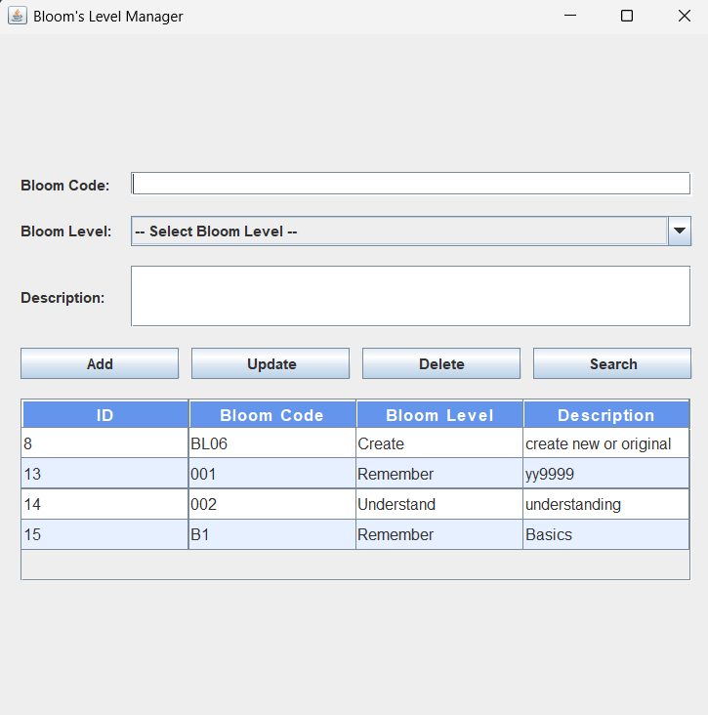
Sample Screen Shots
On Loading the window: Already Stored Records in Databases are Displayed

Slide 14
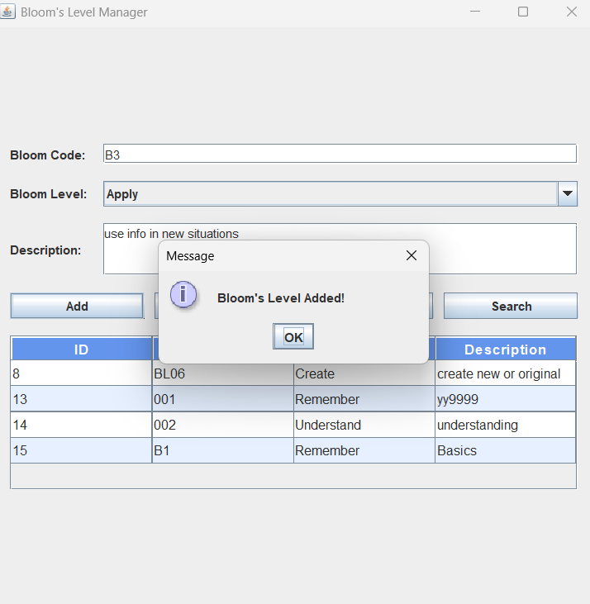
Sample Screen Shots
ADDING a Record with Bloom Code:B3

Slide 15
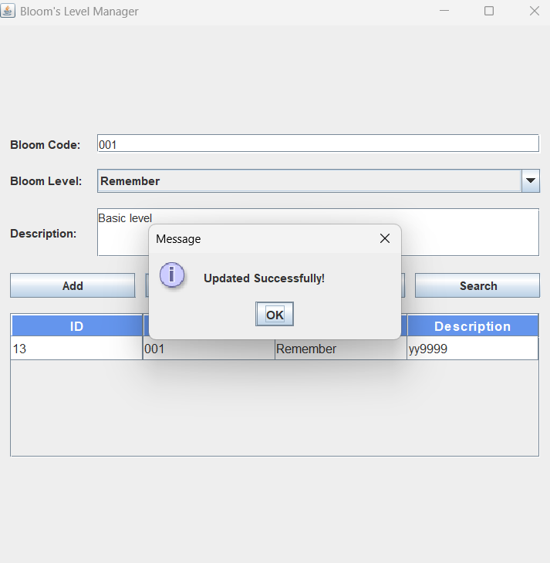
Sample Screen Shots
Updated a Record Description yy9999 is updated with Basic level

Slide 16
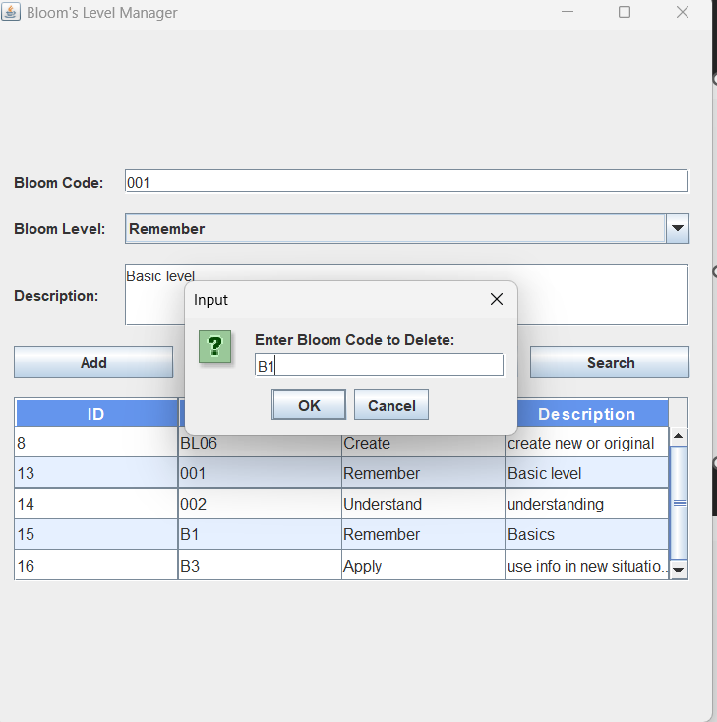
Sample Screen Shots
Delete:

Slide 17
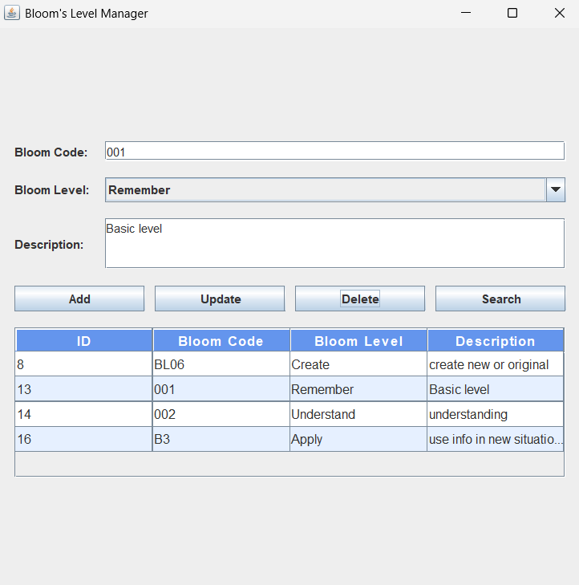
Sample Screen Shots
After Deleted a record:

Slide 18
Conclusion
The Bloom's Level Setting module provides an easy-to-use interface for managing Bloom's taxonomy levels, which are crucial in outcome-based curriculum design. This application fulfills the CRUD functionalities and demonstrates practical application development using Java Swing and SQLite. By integrating this module with other OBE modules, the university can track and assess learning outcomes more effectively and implement OBE standards at every academic level.

Slide 19
Thank You

